Slide 1

Word Representations: Converting Text to Numbers
Advanced Deep Learning Techniques
Dr. Eyal Kolman

Slide 2

Gemini, November 2024

Slide 3
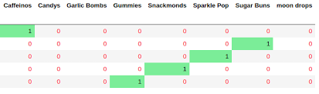
Embeddings: one-hot encoding
Long vectors
No context
For example, D(x,y) is the same for all vectors

Slide 4
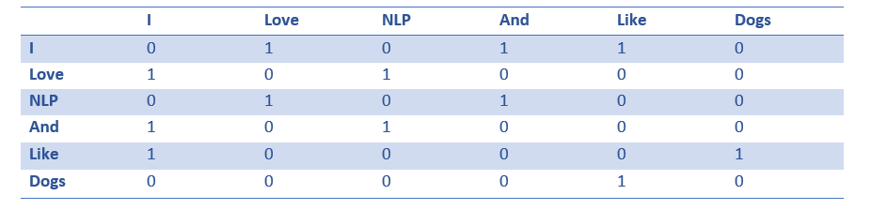
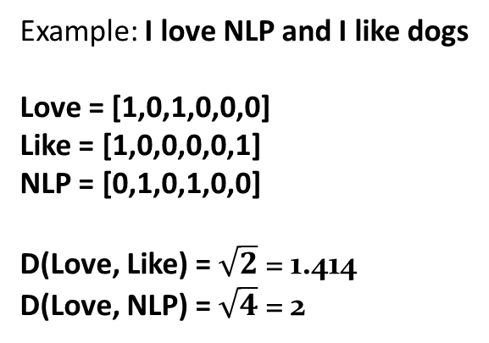
Embeddings: Co-occurrence matrix
Long vectors
Context
Example: I love NLP and I like dogs
Love = [1,0,1,0,0,0]
Like = [1,0,0,0,0,1]
NLP = [0,1,0,1,0,0]
D(Love, Like) = $\sqrt{2}$ = 1.414
D(Love, NLP) = $\sqrt{4}$ = 2

Slide 5
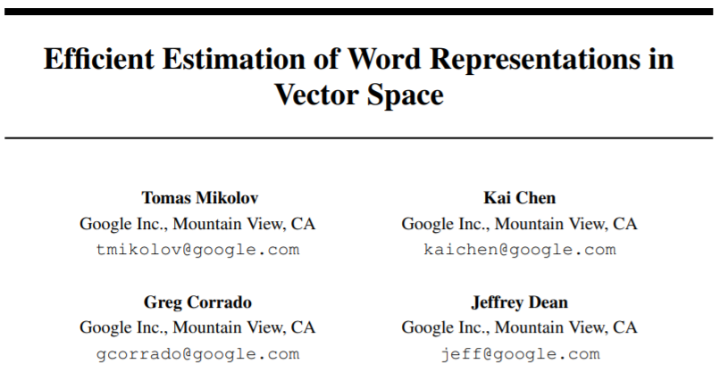
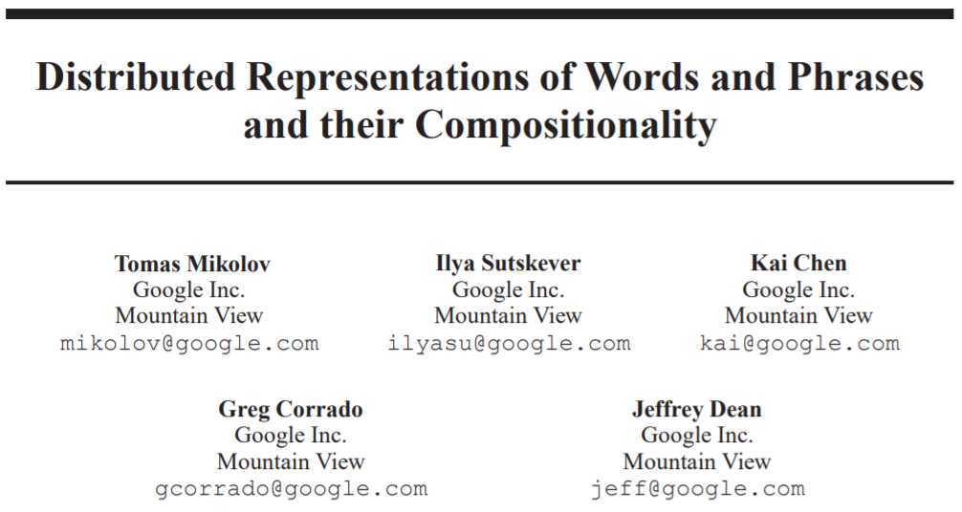
Embeddings: Word2Vec (2013)
34K 41k 45k citations
38K 43k 46k citations

Slide 6
Main Concept
Each word is represented by a numerical vector
Predicting neighbor words based on the word
Dynamic-size vectors (50-300)
Context
Surprising characteristics

Slide 7
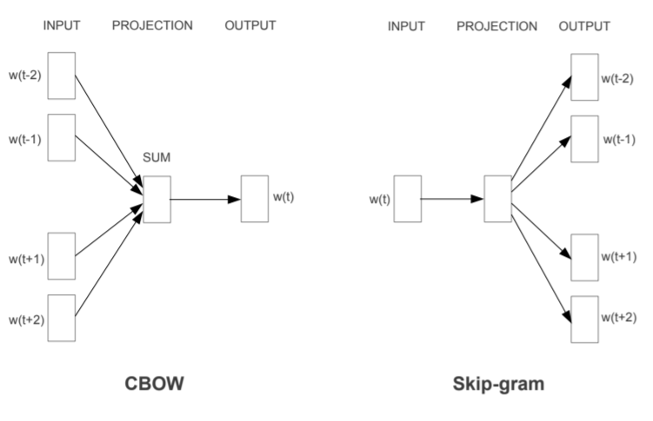
Architecture

Slide 8
Word2Vec: How Does It Work?
Goal: Words that are semantically similar should have similar representations
Means: If two words appear together, move them closer
Love
doughnuts
dogs
cats
NLP
Weekends
Like

Slide 9
Word2Vec: How Does It Work?
Goal: Words that are semantically similar should have similar representations
Means: If two words appear together, move them closer
doughnuts
dogs
cats
NLP
Weekends
Like
Love

Slide 10
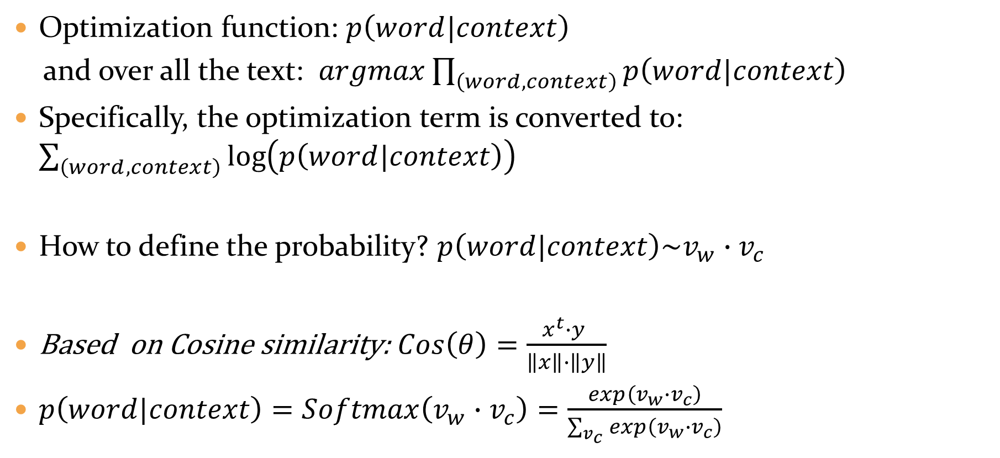
Word2Vec: How Does It Work?
Optimization function: $p\left(word|context\right)$
and over all the text: $\operatorname{argmax}{\prod_{\left(word,context\right)}{p\left(word|context\right)}}$
Specifically, the optimization term is converted to: $\sum_{\left(word,context\right)}{\log\left(p\left(word|context\right)\right)}$
How to define the probability? $p\left(word|context\right)\sim v_{w}∙v_{c}$
Based on Cosine similarity: $Cos\left(θ\right)=\frac{x^{t}∙y }{\left\|x\right\|∙\left\|y\right\|}$
$p\left(word|context\right)=Softmax\left(v_{w}∙v_{c}\right)=\frac{exp\left(v_{w}∙v_{c}\right)}{\sum_{v_{c}}{exp\left(v_{w}∙v_{c}\right)}}$

Slide 11
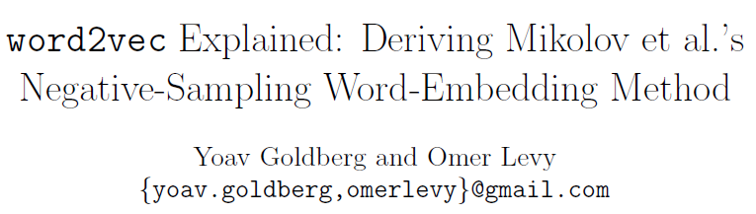
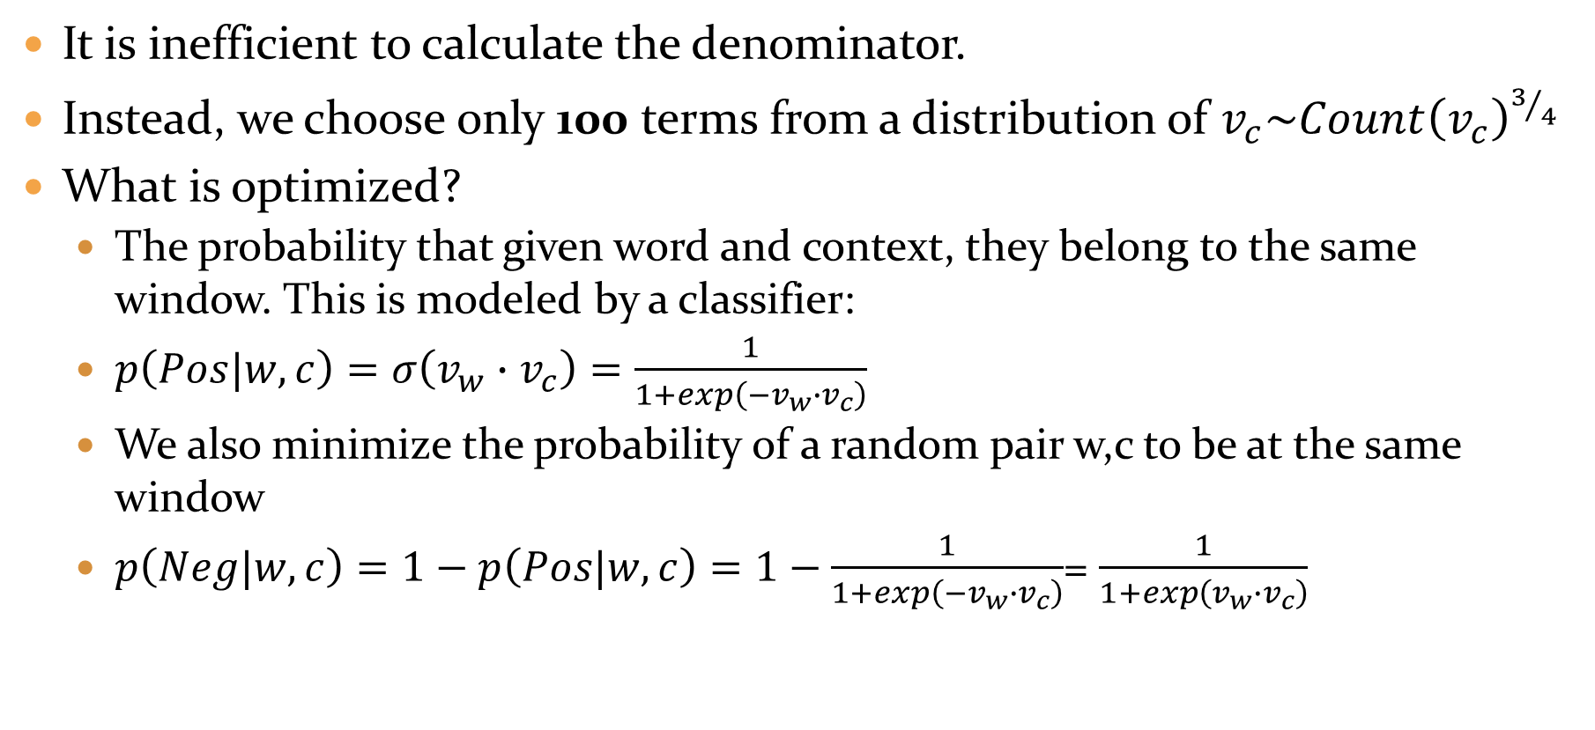
Word2Vec: How Does It Work?
It is inefficient to calculate the denominator.
Instead, we choose only 100 terms from a distribution of $v_{c}\sim {Count\left(v_{c}\right)}^{3/4}$
What is optimized?
The probability that given word and context, they belong to the same window. This is modeled by a classifier:
$p\left(Pos|w,c\right)=σ\left(v_{w}∙v_{c}\right)=\frac{1}{1+exp\left(−v_{w}∙v_{c}\right)}$
We also minimize the probability of a random pair w,c to be at the same window
$p\left(Neg|w,c\right)=1−p\left(Pos|w,c\right)=1−\frac{1}{1+exp\left(−v_{w}∙v_{c}\right)}$= $\frac{1}{1+exp\left(v_{w}∙v_{c}\right)}$
>2300 citations

Slide 12
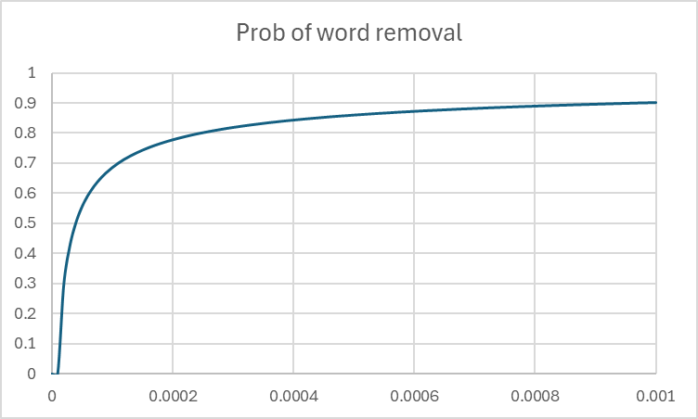
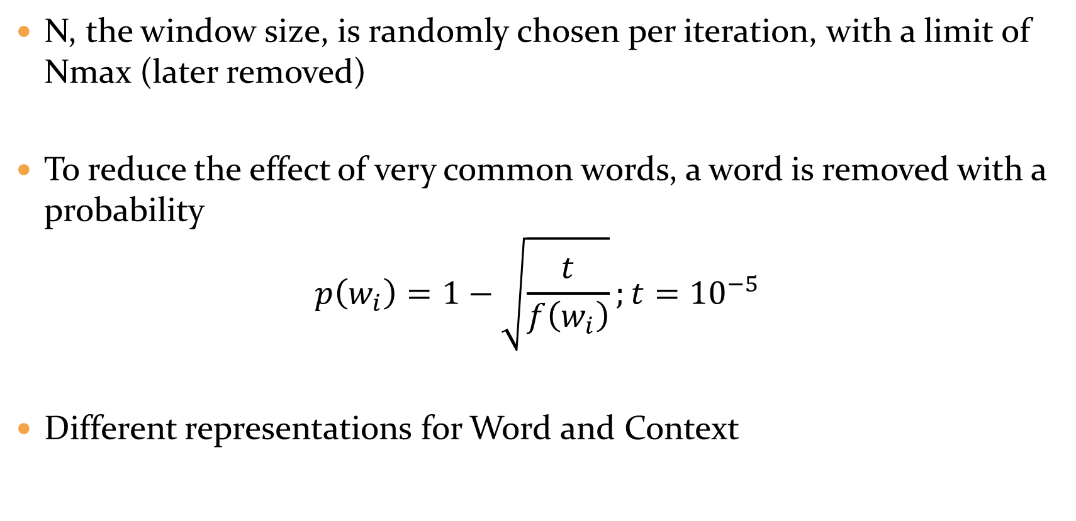
Word2Vec: How Does It Work?
N, the window size, is randomly chosen per iteration, with a limit of Nmax (later removed)
To reduce the effect of very common words, a word is removed with a probability
$$p\left(w_{i}\right)=1−\sqrt{\frac{t}{f\left(w_{i}\right)}};t={10}^{−5}$$
Different representations for Word and Context

Slide 13
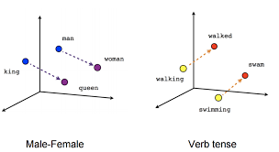
Evaluation
How can we tell if a set of embeddings is Good?
Wrappers: Test using a task(s) and a classifier (e.g., GLUE)
Helpful, but not very efficient
Usually used for classifiers, not features or representations
Semantic-based similarities:
”What is the word that is similar to small in the same sense as biggest is similar to big?”
Calculate: X = V(“biggest”) – V(“big”) + V(“small”)
Extract the closest word to the vector X

Slide 14
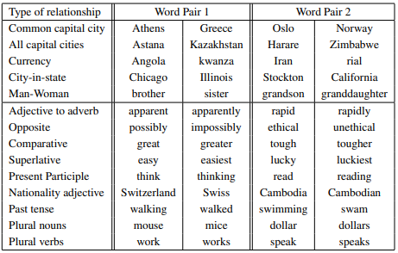
Similarity Types

Slide 15
Train and Test Set Generation
Test:
Create a list of pairs (e.g., 68 city:state in America)
Randomly generate questions from two pairs (2500 city:state questions)
Total: 8869 semantic and 10675 syntactic questions
Train:
Google News corpus, 6B tokens
Vocabulary: 1M most common tokens (and also 30K for comparison with previous works)

Slide 16
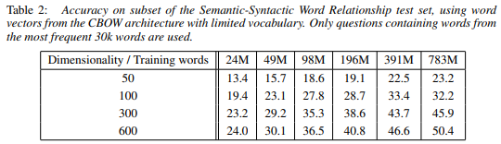
Results
Larger Embeddings → Better Accuracy
Improvement decreases → If your embeddings are not large enough, don’t add data
Best results, using the 1M vocabulary and 1000-dim embeddings: 65.6%

Slide 17
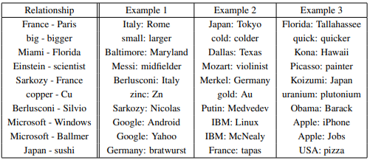
Results examples:

Slide 18
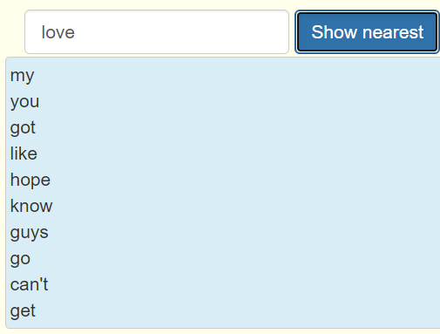
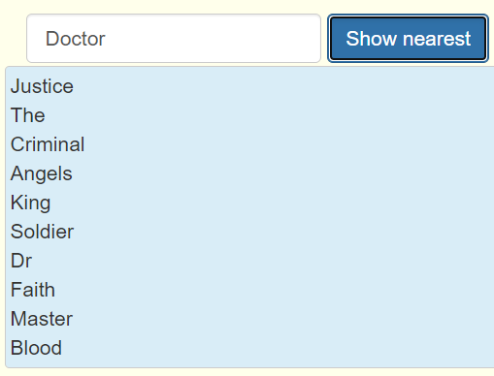
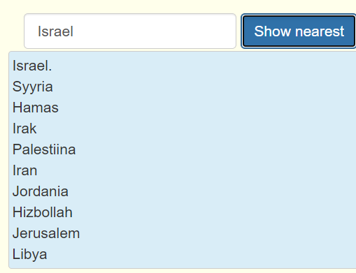
Word2Vec Demo

Slide 19
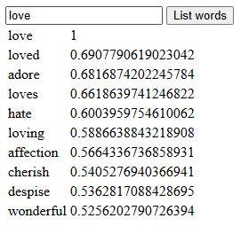
Word2Vec Demo

Slide 20
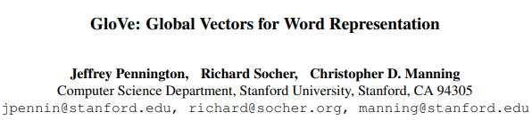

Embeddings: GloVe
2014, 33k 41k 43k citations

Slide 21
Embeddings: GloVe
Word2Vec only learns locally, not utilizing the global statistics
Instead, use the co-occurrence matrix

Slide 22

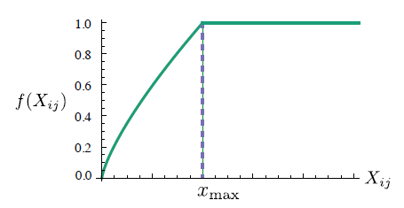

Embeddings: GloVe
Optimization over Co-occurrence matrix
Optimization: $\frac{1}{2}\sum{f\left(P_{ij}\right)}{\left(u_{i}∙v_{j}−log\left(P_{ij}\right)\right)}^{2}$
$P_{ij}$ - Co-occurrence value
Xmax = 100, α = 3/4

Slide 23
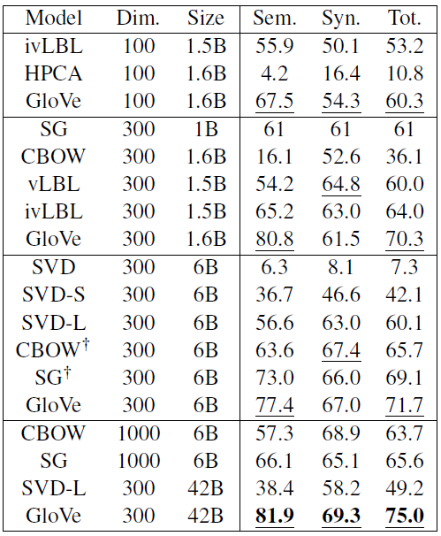
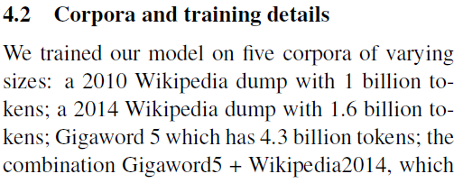


Results

Slide 24
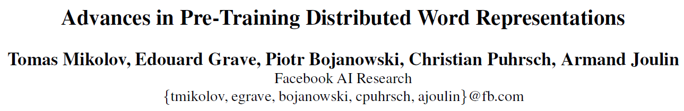

Embeddings: FastText
2017, 1700 citations

Slide 25



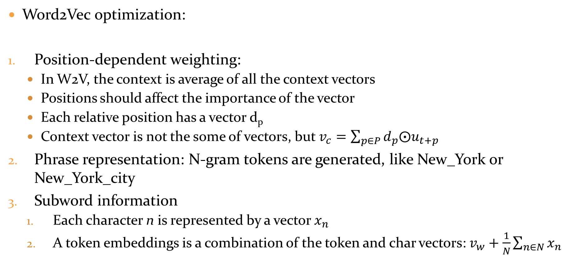
FastText Improvements
Word2Vec optimization:
Position-dependent weighting:
In W2V, the context is average of all the context vectors
Positions should affect the importance of the vector
Each relative position has a vector d_{p}
Context vector is not the some of vectors, but $v_{c}=\sum_{p∈P}{d_{p}⨀u_{t+p}}$
Phrase representation: N-gram tokens are generated, like New_York or New_York_city
Subword information
Each character n is represented by a vector $x_{n}$
A token embeddings is a combination of the token and char vectors: $v_{w}+\frac{1}{N}\sum_{n∈N}{x_{n}}$

Slide 26
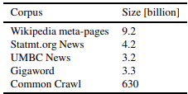

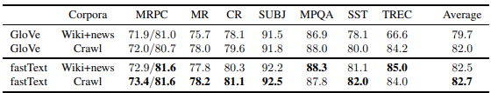
FastText Results
A lot of training data
Results are better over W2V datasets (uniq: sentence level de-duplication over training data)
Results are better over NLP tasks:

Slide 27

My Embeddings…
Goal: Similar co-occurrence matrix columns → close embeddings
Optimization term:
$$\frac{1}{2}\sum{f\left(P_{ij}\right)}{\left(u_{i}∙v_{j}−P_{i}P_{j}\right)}^{2}$$

Slide 28
OOV: Out Of Vocabulary
Representation: Word → Vector
What is the word is not in the vocabulary?
Option 1: Assign a special vector for all OOV tokens
Option 2: Use characters instead of words
Option 3: Break into SubWords

Slide 29
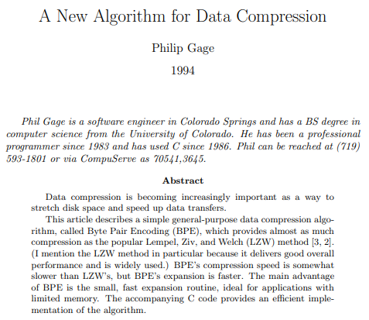
BPE: Byte-Pair Encoding (1994)
1994, 790 1132 1290 citations

Slide 30
BPE Algorithm
Data | Step
aaabdaaabac | aa→Z
ZabdZabac | ab→Y
ZYdZYac | ZY→X
XdXac | No pair appears more than once
In each step, the most frequent pair is replaced by a token
An EOT (End Of Token) or BOT chars are added to the text to know when words begin/end
The algorithm is greedy

Slide 31
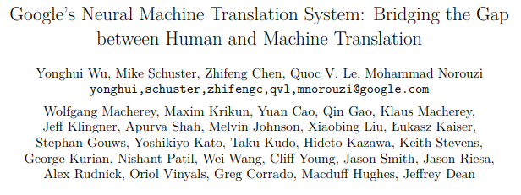
WordPiece
2016, 6,800 8,540 9,086 citations
Used for BERT and BERTish models

Slide 32

WordPiece: Example

Slide 33

WordPiece: Algorithm
Similar to BPE. The difference is how to choose the pair to merge
BPE: Most frequent pair
WordPiece:
$$\{"ab"\}=arg\max_{xy}{\frac{p\left("xy"\right)}{p\left("x"\right)∙p\left("y"\right)}}$$

Slide 34

N-grams
Another topic are specific bi-grams (e.g., “New York Times” or “Chicago Bulls”). These are not represented well by their tokens
Like the BPE approach, Word2Vec generates N-grams if the score is above threshold:
2-4 passes are applied to enable phrases longer than 2 words

Slide 35
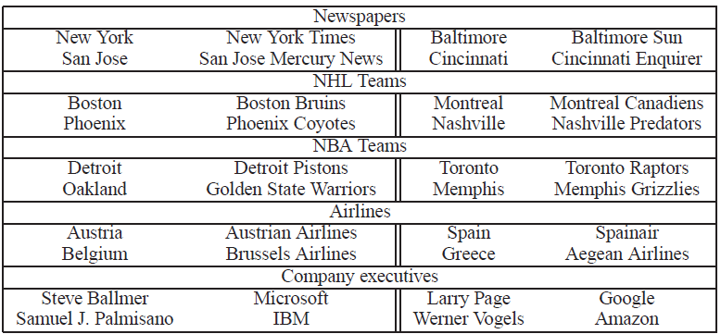
N-grams
A new dataset is defined to evaluate the phrase generation method
Test set contains 3218 examples. Their best result is 72%.

Slide 36
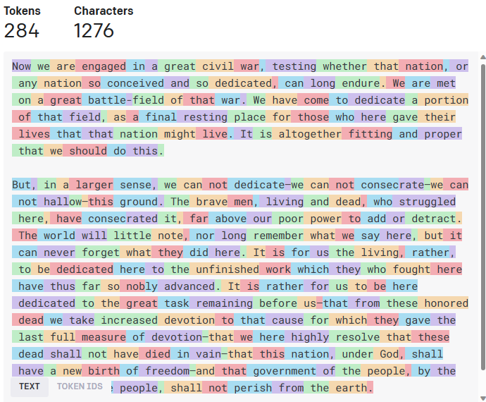
Tokenization Visualization
OpenAI API

Slide 37
Static Word Representations: Drawbacks
watch a play vs. play a game
“He went to prison cell with a cell phone to capture blood cell samples from sick inmates”

Slide 38
PyTorch Code

Slide 39
from transformers import BertTokenizer
if __name__ == '__main__':
PRE_TRAINED_MODEL_NAME = 'bert-base-cased'
tokenizer =BertTokenizer.from_pretrained(PRE_TRAINED_MODEL_NAME)

Slide 40
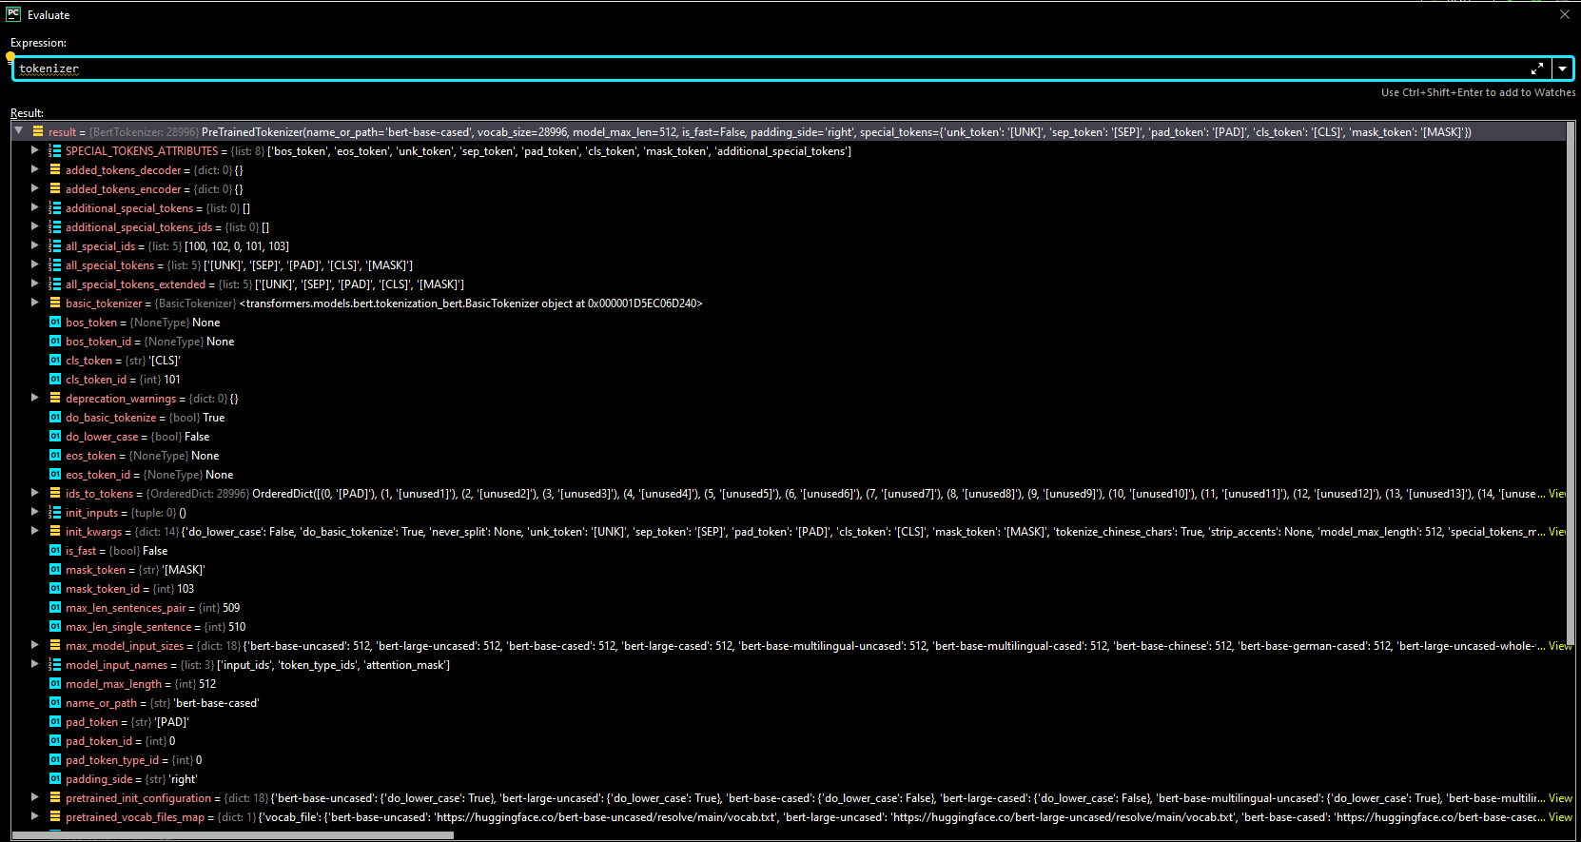

Slide 41
from transformers import BertTokenizer
if __name__ == '__main__':
PRE_TRAINED_MODEL_NAME = 'bert-base-cased'
tokenizer =BertTokenizer.from_pretrained(PRE_TRAINED_MODEL_NAME)

